Slide 1
Academic Quality & ROI in Online Education

Slide 2
Learning Outcomes (incl. Industry Cert Prep): Faculty & Industry Advisors
Student Support Services
Monitoring of 3rd Party ETS Assessments – Start & Finish
Surveys of Alumni
1 Year After Graduation
3rd Party Income Reports
by Grad Cohorts
Surveys of Alumni Employers
CSU Global Quality & ROI

Slide 3
Behind the Scenes: As a CSU Global Student
Student Support Toward Success
High-Quality Learning Experience
Focus on Student Success
Intentional Affordability
- Student learning and outcomes tracked in real time
- 24/7 connection to live 1-on-1 tutoring and technical support
- 24/7 access to Library Resources, Career Development, and Writing Centers
- 1-on-1 live Career Coaching and Writing Consultation sessions
- Ongoing, real-time student identity authentication
- Alternative credit options and transferability
- Stackable credits toward degree completion
- General education curriculum includes soft skills, such as communication, critical thinking, and teamwork
- Each student is assigned a Student Success Counselor for 360-degree support
- Tuition Guarantee and no student fees
- Per-credit-hour costs; pay only when taking classes
- CSU Global has not increased tuition rates since June 2012

Slide 4
Behind the Scenes: As a Student
Learning Outcomes Achievement
Achievement of CSU Global Faculty-Designated and Program Advisory Board-Reviewed Learning Outcomes – Fall 2018
Notes:
Stephanie to share the data and then lead into the next speaker/Sondra on Assessment and Salary data

Slide 5
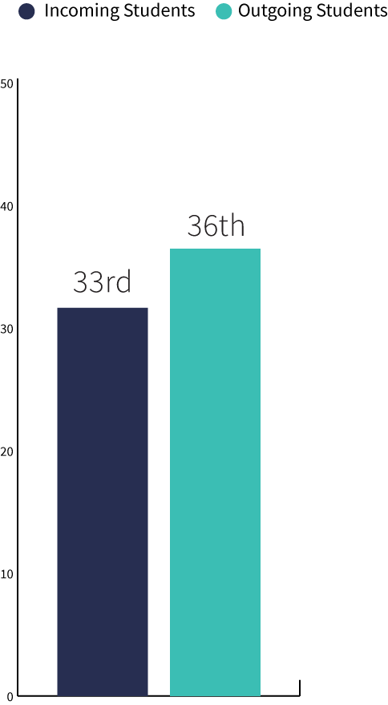
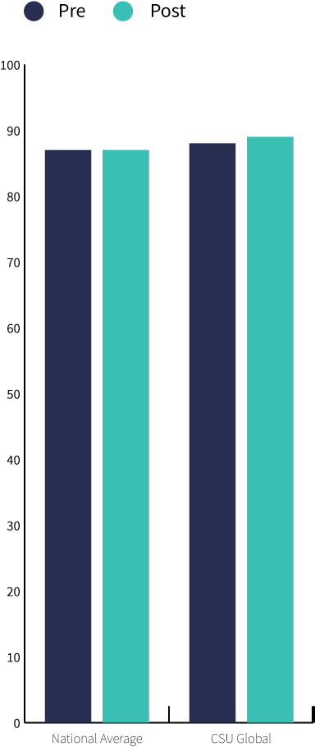
Behind the Scenes: As a Student
Monitoring of ETS Learning Progress Data
National Educational Testing Assessment Scores for CSU Global students against an entire test population of 222,864 students from 155 degree-granting institutions
Comparison of National Schools Mean Percentiles for CSU Global Fall 2016 incoming students vs Fall FY17 Fall trimester graduates.*
Pre-Post Analysis: Mean increases in overall and skills sub-category scores for incoming students from Fall11 – Fall16 who Graduated in FY12 – Fall of FY17.
*Top Percentile to the National School Means from Fall 2019
Notes:
Sondra to explain the highlights of the graphs and data

Slide 6
ROI of Academic Programs
Surveys of Employers
Employer-identified skill for workplace needs |  | Employers who reported that their college grad employees were well prepared* |  | Employers who reported that their CSU Global grad performed extremely well or very well** |  | CSU Global Grads that Strongly Agree or Agree that their education provided the identified skills***
Working with others in teams |  | 37% |  | 90% |  | 91%
Current on technologies |  | 37% |  | 90% |  | 91%
Ethical judgment/decision-making |  | 30% |  | 91% |  | 94%
Oral Communication |  | 28% |  | 92% |  | 89%
Written Communication |  | 27% |  | 91% |  | 89%
Critical Thinking |  | 26% |  | 94% |  | 86%
Analyzing/Solving Complex Problems |  | 24% |  | 87% |  | 91%
Working With People of Diversity |  | 18% |  | 86% |  | 94%
* AASCU Hart Research 2015 | **CSU Global Fall 2015 & 2016 N = 128 | *** CSU Global Fall 2018 N = 68

Slide 7

ROI of Academic Programs
Survey Data from CSU Global Alumni
Alumni 1 year after graduation (Spring 2020)
  95% of alumni were satisfied with their CSU Global education
  92% of alumni would encourage a friend or family member to attend CSU Global
  Alumni self-report an average of 41.6% pay increase post-graduation
  Alumni improved/changed their employment status
    28% secured a better job within their field
    20% secured a job in a new field
    22% received a promotion

Slide 8
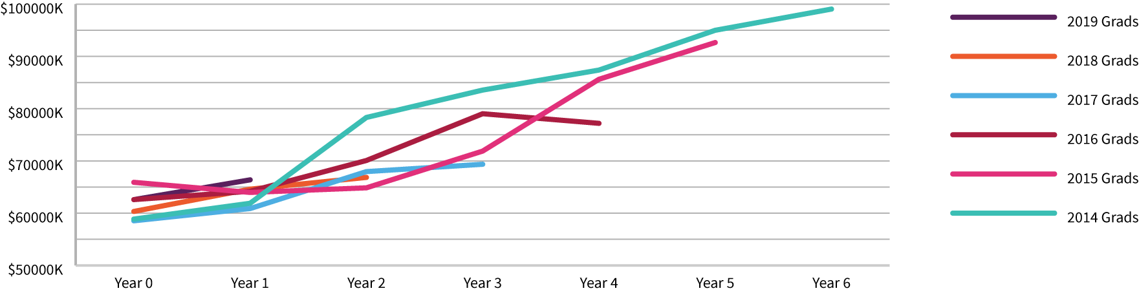
ROI of Academic Programs
Income by Grad Year – Bachelor’s Degrees
CSU Global bachelor’s graduates continue to see salary increases in the years after graduation.
Source: CSU Global Equifax 2018 Graduate Outcomes Analysis

Slide 9
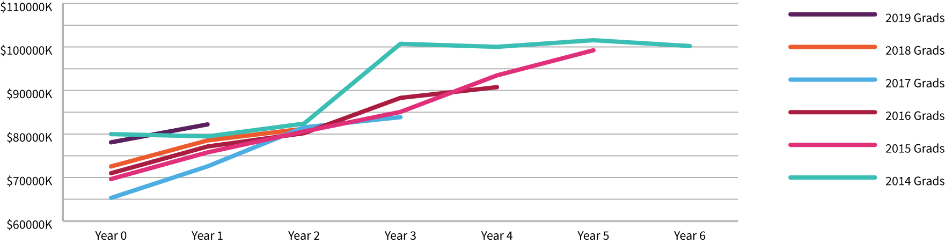
ROI of Academic Programs
Income by Grad Year – Master’s Degrees
CSU Global master’s graduates continue to see salary increases in the years after graduation.
Source: CSU Global Equifax 2018 Graduate Outcomes Analysis

Slide 10
ROI of Academic Programs
CSU Global Alumni vs. Nat’l Average
Degree Achieved |  | National Median Salary* |  | CSU Global Alumni 1st Year ^ |  | CSU Global Alumni 5th Year ^
Bachelor’s degree |  | $ 59,124 |  | $63,964 |  | $92,656
Master’s degree |  | $ 69,732 |  | $75,775 |  | $99,239
* U.S Bureau of Labor Statistics March 2017
^ Third Party Graduate Outcomes Report completion cohort averages for 2015 graduates

Slide 11

Student Perception of Their ROI
“Since starting CSU Global’s M.S. in Management program, I have been promoted into upper management at two different levels as an Administrator 2. The course work and instruction I have received at CSU Global has been crucial for my development.”
– J.L., M.S. in Management Student
“CSU Global's reputation stretches beyond the Colorado state line boundaries. Two weeks before graduation I secured a Business Application Support Analyst position with Adventist Health in Sacramento, CA. My primary focus will be the implementation, administering, and support for their patient-provider web portal access.”
– N.S., B.S. in Information Technology Alumnus

